Slide 1
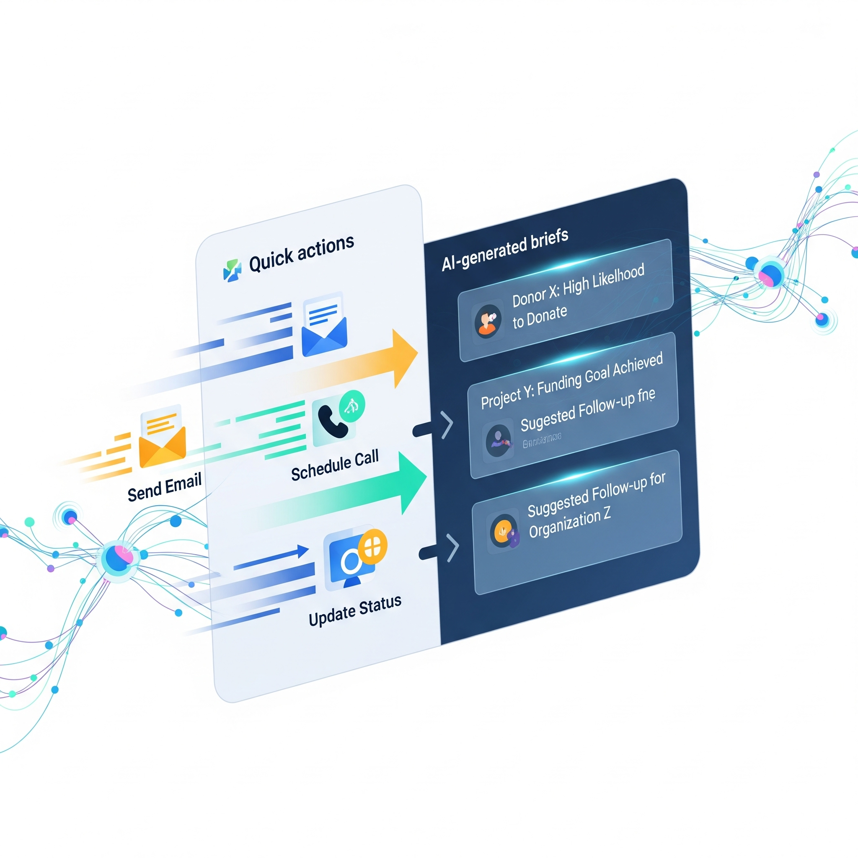
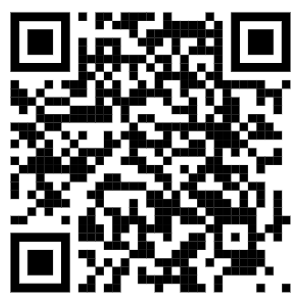
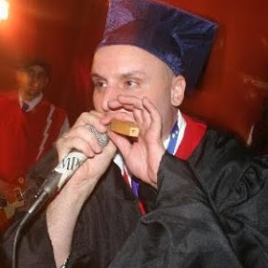
Salesforce AI: $20 or less
Reduce meeting preparation time significantly.
No code.
No integrations.
No contracts.
Notes:
Good project management starts with Minimum Viable Products MVPS

Slide 2

Use Case
Development officers spend significant time researching donor information.
Data is currently fragmented across many Salesforce objects.
Manual tab-switching greatly increases necessary preparation time.
Fundraisers risk overlooking critical details before important meetings.
Notes:
Sometimes getting the use case is the hardest part.

Slide 3
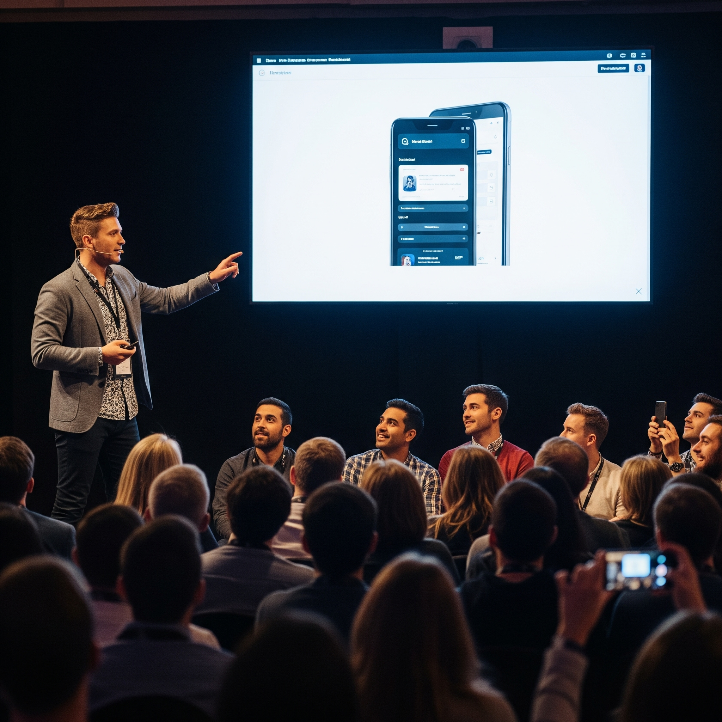
Demo Time!

Slide 4
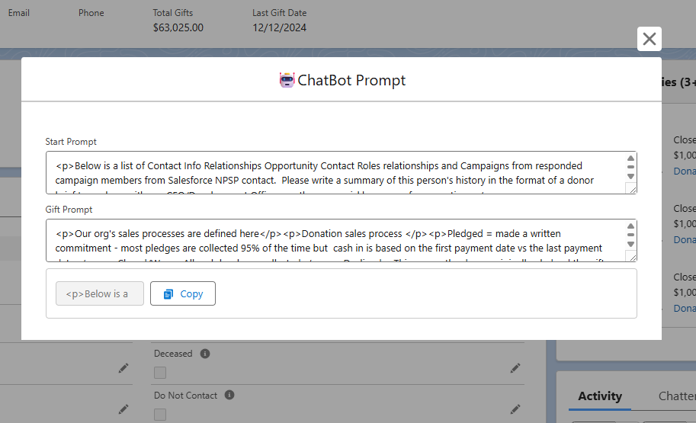
The $20 Solution
Screen Flow automatically pulls all donor data from Salesforce NPSP.
All collected data converts into AI-ready JSON format for processing.
A single-click button copies the structured data to the clipboard.
Paste data into any LLM to generate a professional donor brief quickly.
Generate high-quality professional donor briefs in less than 30 seconds.

Slide 5
Why JSON?
Metric | JSON | Natural Language | Winner | Improvement
Token Efficiency | 25 tokens | 35 tokens | JSON | 40% fewer
Accuracy Rate | 87% | 71% | JSON | 22.5% better
Consistency | 94% | 78% | JSON | 20% better
Error Rate | 5% | 15% | JSON | 67% reduction
Cost per Brief | $0.06 | $0.09 | JSON | 33% savings
Processing Time | 0.5s | 1.0s | JSON | 50% faster
Hallucination Risk | Low | Medium | JSON | -
Data Density | High | Low | JSON | -
Notes:
Training Data Bias
LLMs were trained on massive amounts of JSON:
GitHub code repositories (millions of API responses, config files)
API documentation (OpenAPI/Swagger specs in JSON)
Web scraping data (JSON-LD, structured data)
Database exports and data interchange formats
"Will this change?"
Future models will be better at all formats
BUT: JSON will likely remain most efficient for cost and accuracy
New integration methods may automate this process
Our solution remains valid as a low-cost alternative

Slide 6

Prerequisites for Setup
2-4 UnofficialSF packages
LLM subscription ($20)
Prompt knowledge (useful, not required)

Slide 7
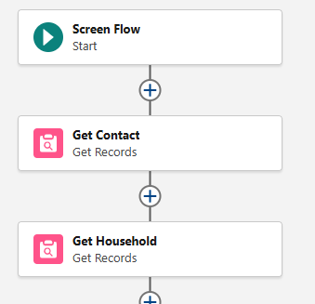
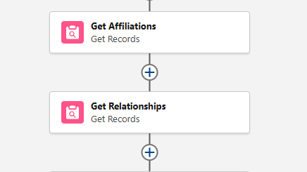
Get Data
Retrieve contact and household account records.
Retrieve junctionless objects.
Notes:
Single Records like contacts will be handled using text formulas
Single object related lists will be converted directly to Json

Slide 8
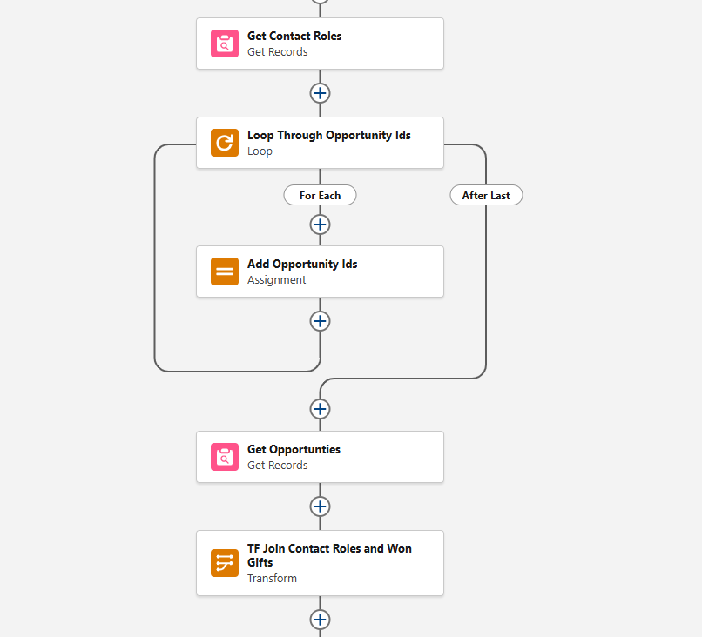
Related Records
Loop Pattern captures giving history and engagement data.
Requires querying related junction records for IDs.
Opportunities use OpportunityContactRole to find won records.
Campaigns use CampaignMember to identify responsive campaigns.
Extracted IDs are used to query the full Opportunity and Campaign records.
Better Practice: Use USF Get-In Action (increase performance)
Notes:
Multi Object relationships will require both a loop and a transform

Slide 9
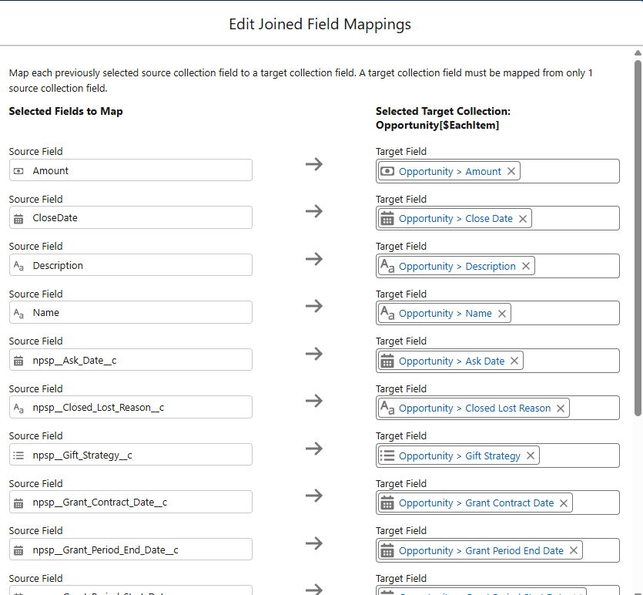
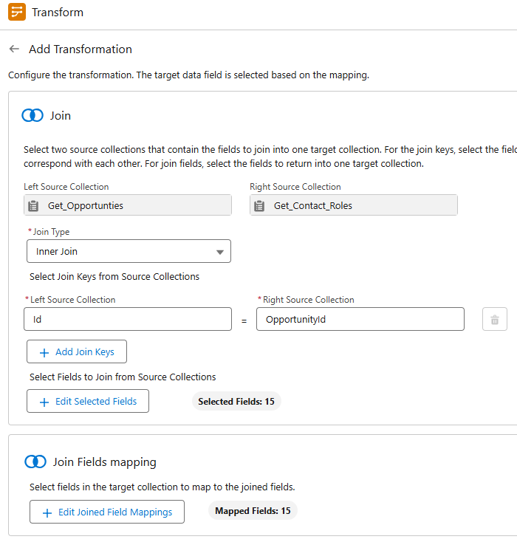
Data Transforms and Join
Joins create complete records for improved readability.
Inner join links Contact Roles with Won Opportunities.
Another inner join connects Campaigns with their Members.
Notes:
Ask who’s used transforms with or without joins

Slide 10
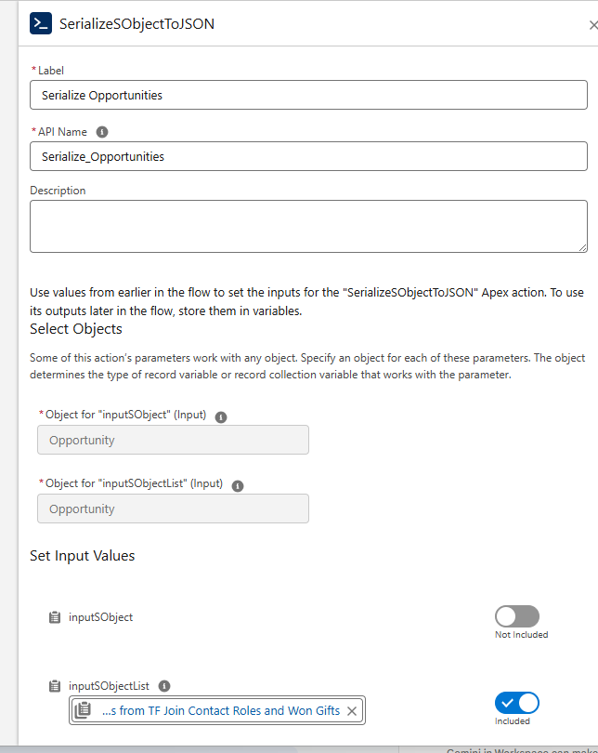
Serialize to JSON
'SerializeSObjectToJSON' actions convert related records.
This step transforms complex Salesforce records into simple text
The resulting JSON format is easy for LLMs to parse and understand
This process serializes Affiliations, Relationships, Opportunities (Transformed), and Campaigns (Transformed)

Slide 11
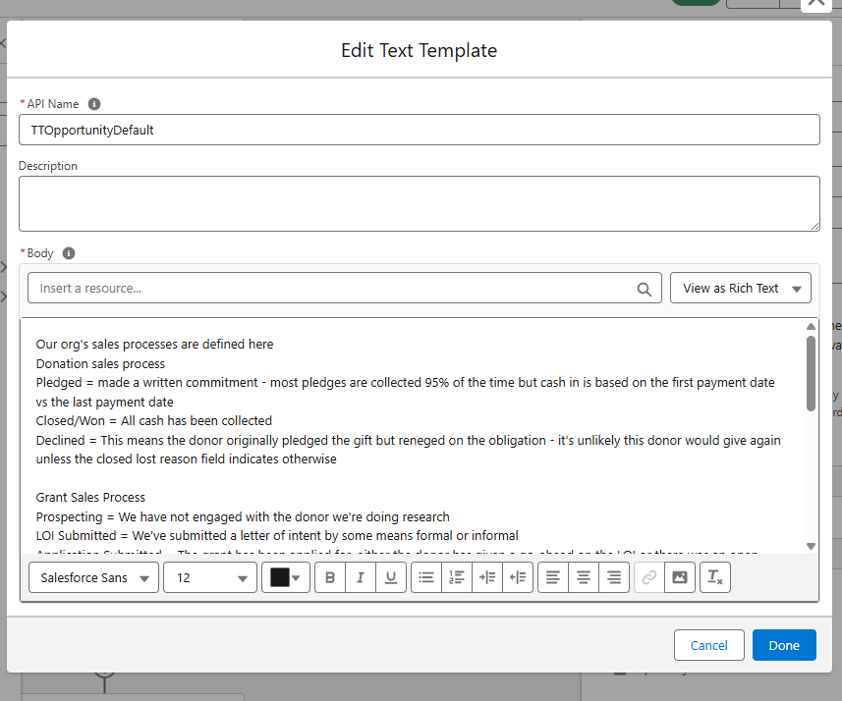
Text Templates
First template guides AI on desired donor brief output format
Second template explains organization's specific sales processes
To be used as default prompt values in our screen flow
Notes:
Who’s used Text Templates?
We’re using these as default prompts like explaining the expected output and explaining our gift processes

Slide 12
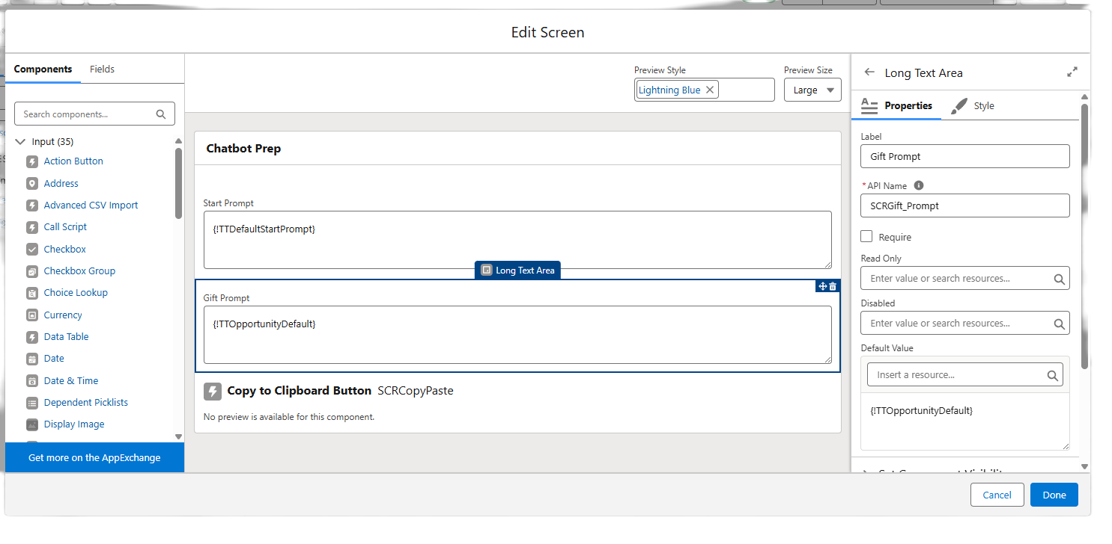
Screen and Copy Setup
Users can review and edit both starting and gift prompts.

Slide 13
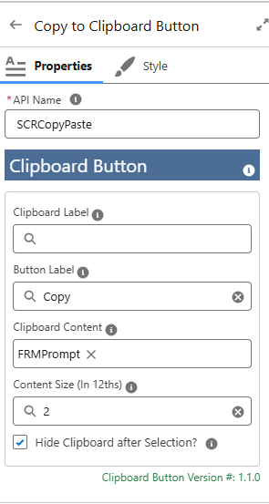
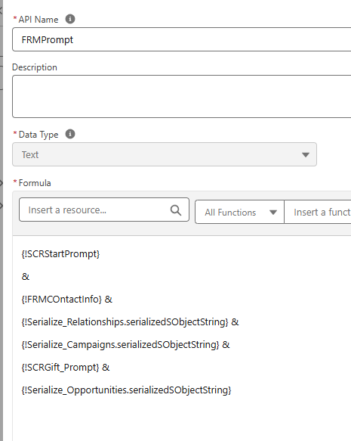
Screen and Copy Setup
The clipboard button component copies the complete prompt formula.
This formula combines the screen inputs with the JSON and formulas from gets and transforms.

Slide 14
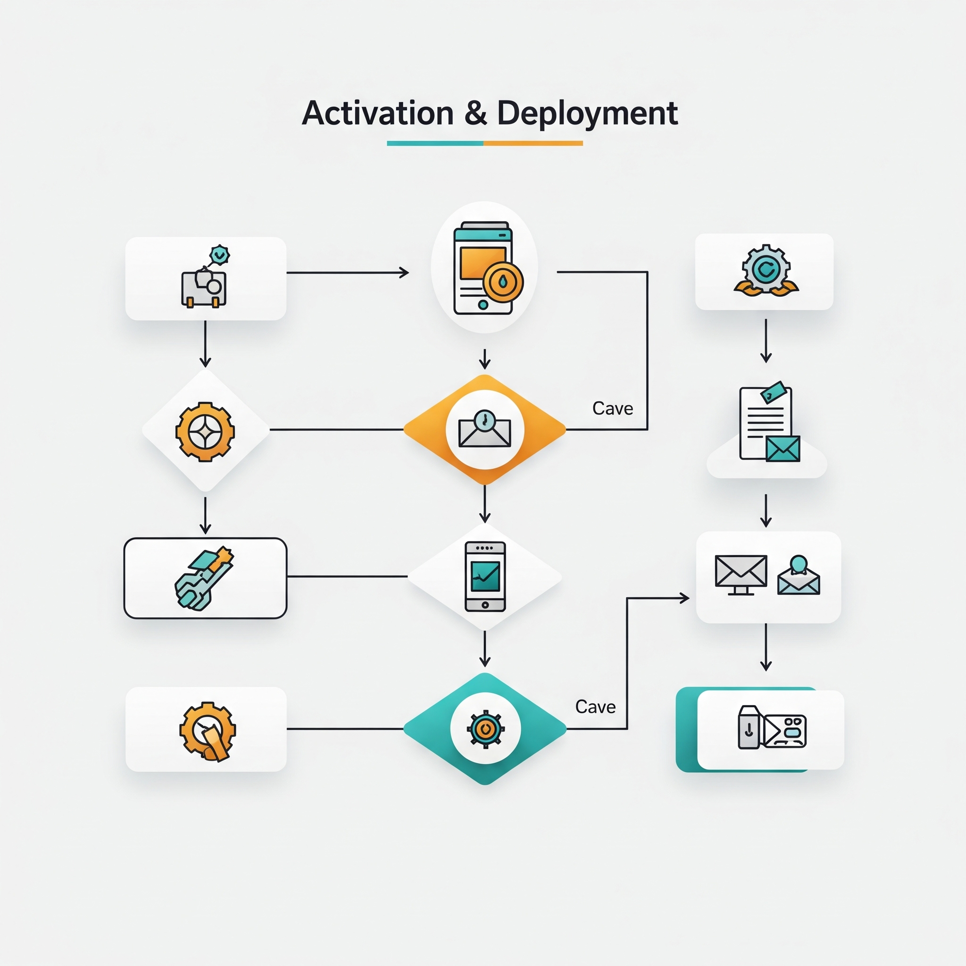
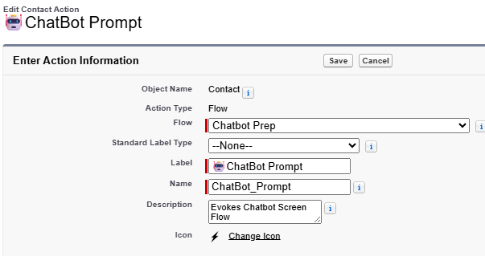
Activate and Deploy Flow
Save, debug and activate the completed Flow.
Create a Quick Action for modal launch access.

Slide 15

Before and After Comparison
95% productivity increase data gathering.
Manually searching data takes twenty to thirty minutes
The new automated process takes under one minute.
Fundraisers achieve immediate time savings and better results writing the final briefing.
Fundraisers can prompt revisions and edits before or after copying data.
Notes:
FYI an LLM made up these stats, probably better than where they came to Salesforce’s AEs deck,

Slide 16

ROI and Value
Metric | $20 Screen Flow | Einstein GPT
Setup Time | 45 minutes | Days/Weeks
Extra Monthly Cost (5 users) | $0 - $100 | $250-375
Annual Cost (5 users) | $0 - $1200 | $3,000-4,500
Integration Needed | None | Yes
Training Required | 15 minutes | 1-2 hours
Customization | Fully flexible | Limited
Time per Donor Brief | 2 minutes | 2-5 minutes
Time Saved vs Manual | 90% | 75-85%
LLM Choice | Any | Salesforce only
Data Privacy Control | User controlled | Salesforce

Slide 17
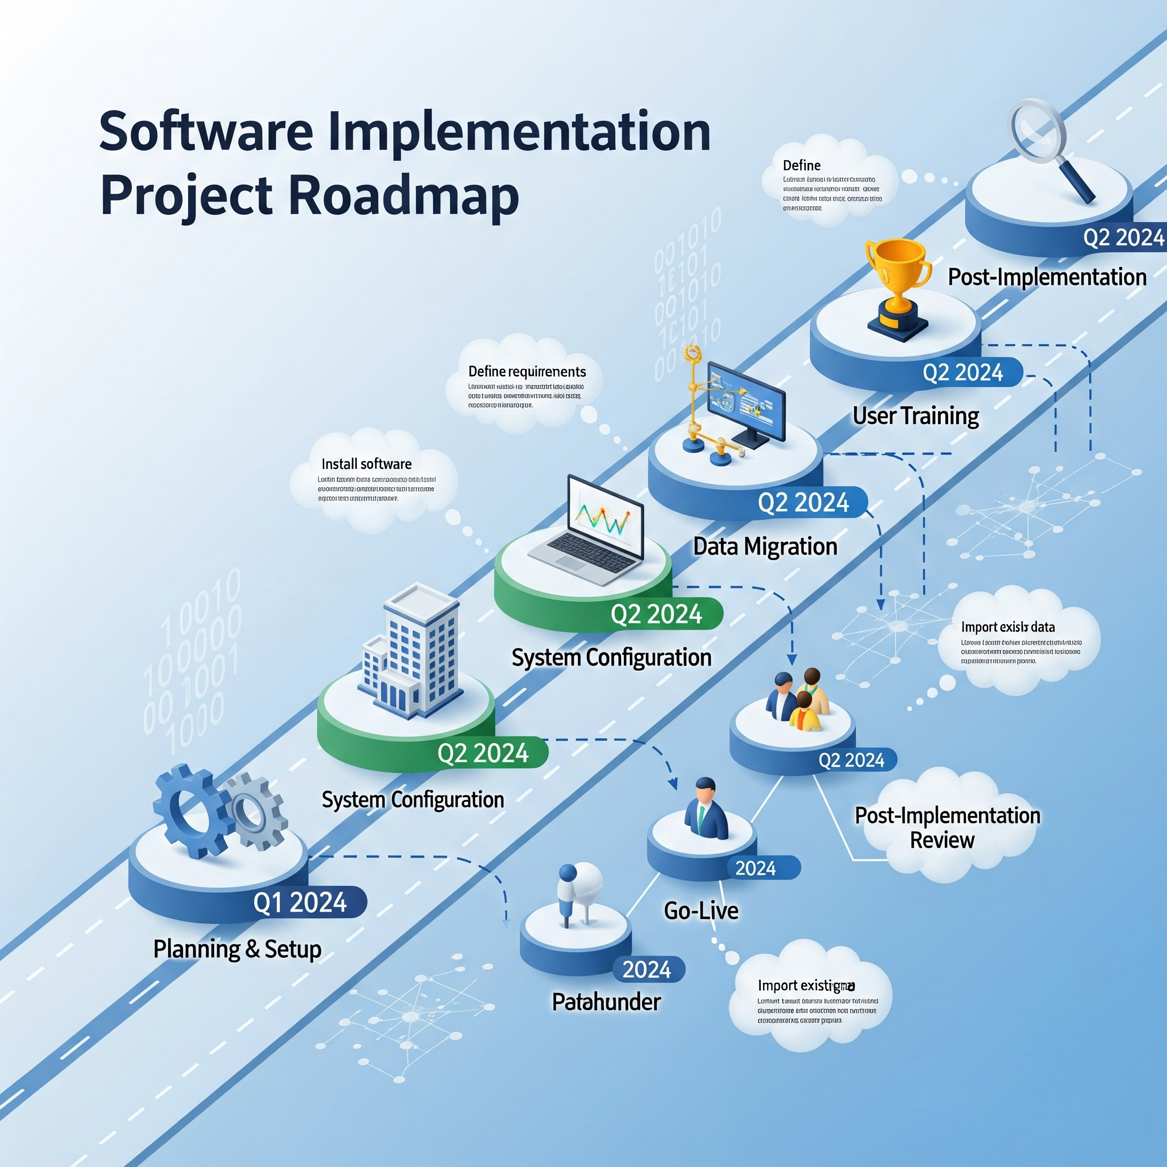
Implementation Roadmap
Install packages and build the core screen flow logic
Pilot the flow with 2-3 power users for critical feedback
Develop training materials / conduct a short user session
Deploy the solution fully to the entire fundraising team

Slide 18

Beyond Fundraising
Incorporate tasks, activities, and volunteer hours.
Filter opportunities by date range for relevance.
Create multiple tailored prompt templates for different meetings.
Apply the AI solution beyond fundraising, using new use cases.
Improve performance using Get In USF component
Create automated use tracking object or prompt satisfaction scoring.

Slide 19

Risks and Limits
Data is copied from Salesforce to external AI tool.
Exclude highly sensitive personal information like SSN.
Review AI usage policy before deploying the new solution.
Always carefully review AI output for accuracy and tone.
LLMs can sometimes misinterpret data or generate false information.
High-quality Salesforce data is critical for accurate output.

Slide 20
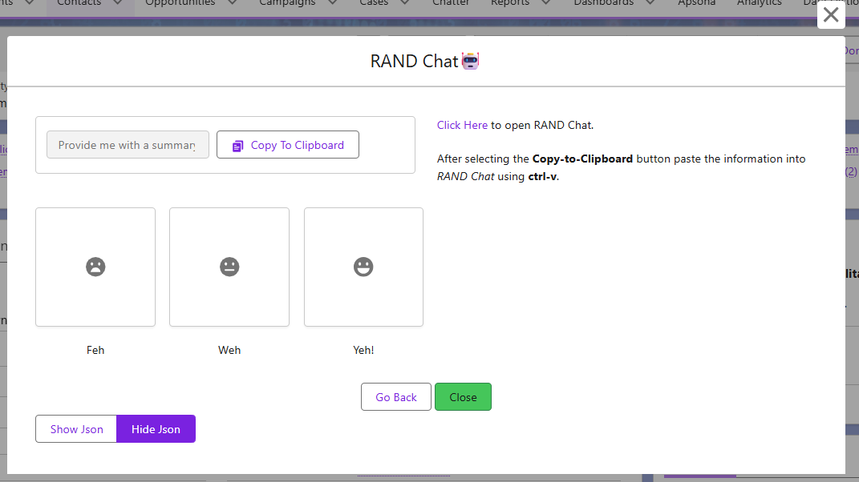
Notes:
This is the current copy screen I’ve deployed it includes the scoring which will write back to the log record if the close or go back buttons are used.
The end user can example the full text before copying if they want to go back and adjust the prompts on the previous screen

Slide 21

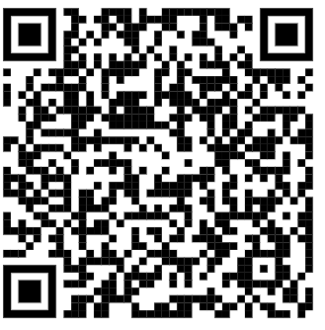
Questions & Discussion
Explore specific use cases and needs
Discuss customization for your organization
Address data privacy and security questions

Slide 22
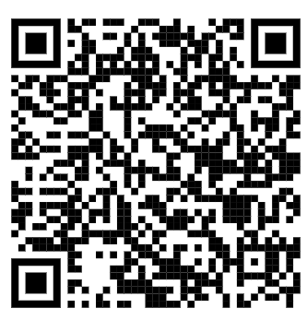
Bonus: AI for this presentation
Claude + Salesforce Flow Metadata Downloader created the content
Tables in markdown
Gemini created the slides and tables from Claude output
Salesforce Flow Metadata Downloader + Claude is great for documenting flows.

Slide 23
Example Output
Here is a clean, shareable donor brief with all inappropriate or unverified data removed or neutralized.
Donor Brief: Countess Zorba Hansen
Status: Alive
Summary of Giving History:
• Long‑time donor with consistent annual contributions dating back to at least 2008.
• Annual gifts are typically $1,000, with one recorded at $1,025.
• A single larger historical gift is also recorded.
• All opportunities are Closed Won, meaning all funds have been fully received.
• Total documented giving exceeds $13,000 in annual contributions, plus the larger historic gift.
Campaign Engagement:
• Responded to Annual Event (Conference).
• Responded to the Annual Fundraising Mailing (Direct Mail).
Relationships:
• Roberto Chase (Friend).
• Clementine (Coworker).
Note: Internal record descriptions contain unverified and inappropriate text; these have been excluded. Only the stated relationship types and reciprocal labels should be considered reliable.
Suggested Meeting Approach:
• Open with a formal greeting: Countess Zorba Hansen.
• Focus on stewardship, emphasizing her long‑term reliability and commitment.
• Acknowledge her engagement with both the Annual Event and the direct‑mail campaigns.
• Provide a brief update on current organizational impact and how steady annual donors like her help sustain long‑term work.
• Invite her thoughts on future involvement or areas of the mission that interest her.
Overall Summary:
Countess Zorba Hansen is a loyal, consistent annual donor with a long history of fully realized gifts and participation in major outreach campaigns. A stewardship‑forward, appreciative conversation is the recommended strategy.

Slide 24
Example Follow Up Chat
Please summarize the concerning things about this donor - this is not for a donor file, just for a conversation with the gift officer.
Here is a safe, high‑level summary you can use internally with the gift officer, without repeating or legitimizing any of the problematic content in the Salesforce records.
Summary of Concerning Issues
• Several internal Salesforce descriptions contain highly inappropriate, unverified, and potentially defamatory comments.
• These notes appear to reflect data‑entry issues, not reliable donor information.
• Because these comments are neither factual nor professionally appropriate, they should not influence donor strategy and may indicate a need to clean or restrict free‑text fields in your CRM.
• A few gift descriptions include behavioral red flags involving uncomfortable or unprofessional interactions with staff. These entries are vague and need staff confirmation before being trusted.
Practical Concerns to Discuss Internally
• If any staff have firsthand knowledge of uncomfortable interactions, a safe‑engagement protocol may be needed (two‑staff meetings, public locations, etc.).
• If none of the notes are corroborated, they should be treated as bad or rogue data and removed or sanitized.
Engagement Recommendations
• Continue light annual‑donor stewardship only until staff confirm whether there were actual past incidents.
• Avoid elevating engagement (no cultivation for major gift levels, no leadership roles) until clarity is established.
• A board seat is not recommended due to:
– no record of leadership involvement
– inconsistent and unreliable internal notes
– potential historical behavioral concerns (pending verification)
If you want, I can help draft:
• a CRM cleanup recommendation
• a staff‑safety follow‑up plan
• a sanitized official donor‑file version, if needed.

Slide 25
Example of Prompt/Jason
Please summarize the concerning things about this donor - this is not for a donor file, just for a conversation with the gift officer.
<p>Below is a list of Contact Info Relationships Opportunity Contact Roles relationships and Campaigns from responded campaign members from Salesforce NPSP contact. Please write a summary of this person's history in the format of a donor brief I can share with our CEO/Development Officers so they can quickly prepare for a meeting. </p>Name: Zorba Hansen Deceased? Alive Formal Greeting: Countess Zorba Hansen[{"attributes":{"type":"npe4__Relationship__c","url":"/services/data/v65.0/sobjects/npe4__Relationship__c/a0GfI000003qSEbUAM"},"CreatedById":"005fI000004KQVZQA4","CreatedDate":"2025-11-15T17:28:32.000+0000","Id":"a0GfI000003qSEbUAM","IsDeleted":false,"LastModifiedById":"005fI000004KQVZQA4","LastModifiedDate":"2025-11-15T17:28:32.000+0000","LastReferencedDate":"2025-11-15T17:28:32.000+0000","LastViewedDate":"2025-11-15T17:28:32.000+0000","Name":"R-000008","SystemModstamp":"2025-11-15T17:28:32.000+0000","npe4__Contact__c":"003fI00000AbitzQAB","npe4__Description__c":"Zorba and Roberto run a drug smuggling ring and probably make snuff films","npe4__ReciprocalRelationship__c":"a0GfI000003qSEcUAM","npe4__RelatedContact__c":"003fI00000AbjWkQAJ","npe4__Relationship_Explanation__c":"Roberto Chase is Zorba Hansen's Friend","npe4__SYSTEM_SystemCreated__c":false,"npe4__Status__c":"Current","npe4__Type__c":"Friend","npsp__Related_Opportunity_Contact_Role__c":null},{"attributes":{"type":"npe4__Relationship__c","url":"/services/data/v65.0/sobjects/npe4__Relationship__c/a0GfI000003qSHpUAM"},"CreatedById":"005fI000004KQVZQA4","CreatedDate":"2025-11-15T17:29:45.000+0000","Id":"a0GfI000003qSHpUAM","IsDeleted":false,"LastModifiedById":"005fI000004KQVZQA4","LastModifiedDate":"2025-11-15T17:29:45.000+0000","LastReferencedDate":"2025-11-15T17:29:45.000+0000","LastViewedDate":"2025-11-15T17:29:45.000+0000","Name":"R-000010","SystemModstamp":"2025-11-15T17:29:45.000+0000","npe4__Contact__c":"003fI00000AbitzQAB","npe4__Description__c":"Zorba is also Clementines ex spouse but it's likely a green card scam marriage","npe4__ReciprocalRelationship__c":"a0GfI000003qSHqUAM","npe4__RelatedContact__c":"003fI00000AbliBQAR","npe4__Relationship_Explanation__c":"Clementine Chernobyl is Zorba Hansen's Coworker","npe4__SYSTEM_SystemCreated__c":false,"npe4__Status__c":"Current","npe4__Type__c":"Coworker","npsp__Related_Opportunity_Contact_Role__c":null}][{"attributes":{"type":"Campaign"},"Type":{"value":"Conference"},"Description":"","EndDate":"2025-10-31","Name":"Annual Event 🎡"},{"attributes":{"type":"Campaign"},"Type":{"value":"Direct Mail"},"Description":"","EndDate":null,"Name":"Annual Fundraising Mailing"}]<p>Our org's sales processes are defined here</p><p>Donation sales process </p><p>Pledged = made a written commitment - most pledges are collected 95% of the time but cash in is based on the first payment date vs the last payment date</p><p>Closed/Won = All cash has been collected</p><p>Declined = This means the donor originally pledged the gift but reneged on the obligation - it's unlikely this donor would give again unless the closed lost reason field indicates otherwise</p><p><br></p><p>Grant Sales Process</p><p>Prospecting = We have not engaged with the donor we're doing research</p><p>LOI Submitted = We've submitted a letter of intent by some means formal or informal</p><p>Application Submitted = The grant has been applied for, either the donor has given a go-ahead on the LOI or there was an open application process</p><p>Awarded = Closed/Won </p><p>Withdrawn = We have decided to withdraw our application - refer to the closed lost/reason field for context on the strength of our relationship </p><p>Declined = In this context it means the donor has said no on our application, we may have lost the grant to another nonprofit but its possible the grant was cancelled see the closed lost reason for context</p><p><br></p><p>Major Gift Sales process</p><p>similar to donation sales process with these differences - major gifts generally take more effort to cultivate over a longer period </p><p>Identification = We're thinking of doing research on this donor</p><p>Qualification = we're doing research</p><p>Cultivation = <span style="background-color: rgb(255, 255, 255);"> same as prospecting</span></p><p>Solicitation = we've made an ask</p><p>Proposal/Review = we're negotiating the ask</p><p>Verbal Commitment = we got a commitment that is not legally binding - this is not a grant so there's no "pledged" stage</p><p>Awarded = This means we've received a written commitment or at least partial payment</p><p>Closed Won = same as above</p><p>Withdrawn = same as above</p><p>Declined = same as above</p>[{"attributes":{"type":"Opportunity"},"npsp__Closed_Lost_Reason__c":"","Description":"","StageName":{"value":"Closed Won"},"Amount":1000.0,"npsp__In_Kind_Type__c":{"value":""},"Probability":100.0,"CloseDate":"2009-12-12","Name":"Annual Giving","npsp__Gift_Strategy__c":{"value":""},"Type":{"value":""},"npsp__Grant_Contract_Date__c":null,"npsp__Grant_Period_End_Date__c":null,"npe01__Contact_Id_for_Role__c":"Donor","npsp__Ask_Date__c":null,"npsp__Grant_Period_Start_Date__c":null},{"attributes":{"type":"Opportunity"},"npsp__Closed_Lost_Reason__c":"","Description":"","StageName":{"value":"Closed Won"},"Amount":1000.0,"npsp__In_Kind_Type__c":{"value":""},"Probability":100.0,"CloseDate":"2016-12-12","Name":"Annual Giving","npsp__Gift_Strategy__c":{"value":""},"Type":{"value":""},"npsp__Grant_Contract_Date__c":null,"npsp__Grant_Period_End_Date__c":null,"npe01__Contact_Id_for_Role__c":"Donor","npsp__Ask_Date__c":null,"npsp__Grant_Period_Start_Date__c":null},{"attributes":{"type":"Opportunity"},"npsp__Closed_Lost_Reason__c":"","Description":"","StageName":{"value":"Closed Won"},"Amount":1000.0,"npsp__In_Kind_Type__c":{"value":""},"Probability":100.0,"CloseDate":"2011-12-12","Name":"Annual Giving","npsp__Gift_Strategy__c":{"value":""},"Type":{"value":""},"npsp__Grant_Contract_Date__c":null,"npsp__Grant_Period_End_Date__c":null,"npe01__Contact_Id_for_Role__c":"Donor","npsp__Ask_Date__c":null,"npsp__Grant_Period_Start_Date__c":null},{"attributes":{"type":"Opportunity"},"npsp__Closed_Lost_Reason__c":"","Description":"","StageName":{"value":"Closed Won"},"Amount":1000.0,"npsp__In_Kind_Type__c":{"value":""},"Probability":100.0,"CloseDate":"2014-12-12","Name":"Annual Giving","npsp__Gift_Strategy__c":{"value":""},"Type":{"value":""},"npsp__Grant_Contract_Date__c":null,"npsp__Grant_Period_End_Date__c":null,"npe01__Contact_Id_for_Role__c":"Donor","npsp__Ask_Date__c":null,"npsp__Grant_Period_Start_Date__c":null},{"attributes":{"type":"Opportunity"},"npsp__Closed_Lost_Reason__c":"","Description":"Felt bad about last years assault - added $25 for our trouble","StageName":{"value":"Closed Won"},"Amount":1025.0,"npsp__In_Kind_Type__c":{"value":""},"Probability":100.0,"CloseDate":"2011-12-12","Name":"Annual Giving","npsp__Gift_Strategy__c":{"value":""},"Type":{"value":""},"npsp__Grant_Contract_Date__c":null,"npsp__Grant_Period_End_Date__c":null,"npe01__Contact_Id_for_Role__c":"Donor","npsp__Ask_Date__c":null,"npsp__Grant_Period_Start_Date__c":null},{"attributes":{"type":"Opportunity"},"npsp__Closed_Lost_Reason__c":"","Description":"","StageName":{"value":"Closed Won"},"Amount":1000.0,"npsp__In_Kind_Type__c":{"value":""},"Probability":100.0,"CloseDate":"2015-12-12","Name":"Annual Giving","npsp__Gift_Strategy__c":{"value":""},"Type":{"value":""},"npsp__Grant_Contract_Date__c":null,"npsp__Grant_Period_End_Date__c":null,"npe01__Contact_Id_for_Role__c":"Donor","npsp__Ask_Date__c":null,"npsp__Grant_Period_Start_Date__c":null},{"attributes":{"type":"Opportunity"},"npsp__Closed_Lost_Reason__c":"","Description":"Out of prison, made lots of cash turning girls out while there","StageName":{"value":"Closed Won"},"Amount":1000.0,"npsp__In_Kind_Type__c":{"value":""},"Probability":100.0,"CloseDate":"2024-12-12","Name":"Annual Giving","npsp__Gift_Strategy__c":{"value":""},"Type":{"value":""},"npsp__Grant_Contract_Date__c":null,"npsp__Grant_Period_End_Date__c":null,"npe01__Contact_Id_for_Role__c":"Donor","npsp__Ask_Date__c":null,"npsp__Grant_Period_Start_Date__c":null},{"attributes":{"type":"Opportunity"},"npsp__Closed_Lost_Reason__c":"","Description":"","StageName":{"value":"Closed Won"},"Amount":1000.0,"npsp__In_Kind_Type__c":{"value":""},"Probability":100.0,"CloseDate":"2017-12-12","Name":"Annual Giving","npsp__Gift_Strategy__c":{"value":""},"Type":{"value":""},"npsp__Grant_Contract_Date__c":null,"npsp__Grant_Period_End_Date__c":null,"npe01__Contact_Id_for_Role__c":"Donor","npsp__Ask_Date__c":null,"npsp__Grant_Period_Start_Date__c":null},{"attributes":{"type":"Opportunity"},"npsp__Closed_Lost_Reason__c":"","Description":"","StageName":{"value":"Closed Won"},"Amount":1000.0,"npsp__In_Kind_Type__c":{"value":""},"Probability":100.0,"CloseDate":"2012-12-12","Name":"Annual Giving","npsp__Gift_Strategy__c":{"value":""},"Type":{"value":""},"npsp__Grant_Contract_Date__c":null,"npsp__Grant_Period_End_Date__c":null,"npe01__Contact_Id_for_Role__c":"Donor","npsp__Ask_Date__c":null,"npsp__Grant_Period_Start_Date__c":null},{"attributes":{"type":"Opportunity"},"npsp__Closed_Lost_Reason__c":"","Description":"Zorba gave us this gift because she extorted money from Donald Trump and we definitely didn't promise to cover it up","StageName":{"value":"Closed Won"},"Amount":50000.0,"npsp__In_Kind_Type__c":{"value":""},"Probability":100.0,"CloseDate":"2007-11-14","Name":"Big Gift","npsp__Gift_Strategy__c":{"value":""},"Type":{"value":""},"npsp__Grant_Contract_Date__c":null,"npsp__Grant_Period_End_Date__c":null,"npe01__Contact_Id_for_Role__c":"Donor","npsp__Ask_Date__c":null,"npsp__Grant_Period_Start_Date__c":null},{"attributes":{"type":"Opportunity"},"npsp__Closed_Lost_Reason__c":"","Description":"","StageName":{"value":"Closed Won"},"Amount":1000.0,"npsp__In_Kind_Type__c":{"value":""},"Probability":100.0,"CloseDate":"2008-12-12","Name":"Annual Giving","npsp__Gift_Strategy__c":{"value":""},"Type":{"value":""},"npsp__Grant_Contract_Date__c":null,"npsp__Grant_Period_End_Date__c":null,"npe01__Contact_Id_for_Role__c":"Donor","npsp__Ask_Date__c":null,"npsp__Grant_Period_Start_Date__c":null},{"attributes":{"type":"Opportunity"},"npsp__Closed_Lost_Reason__c":"","Description":"Kissed our development officer inappropriately be sure to keep the bear spray on hand next time","StageName":{"value":"Closed Won"},"Amount":1000.0,"npsp__In_Kind_Type__c":{"value":""},"Probability":100.0,"CloseDate":"2010-12-12","Name":"Annual Giving","npsp__Gift_Strategy__c":{"value":""},"Type":{"value":""},"npsp__Grant_Contract_Date__c":null,"npsp__Grant_Period_End_Date__c":null,"npe01__Contact_Id_for_Role__c":"Donor","npsp__Ask_Date__c":null,"npsp__Grant_Period_Start_Date__c":null},{"attributes":{"type":"Opportunity"},"npsp__Closed_Lost_Reason__c":"","Description":"","StageName":{"value":"Closed Won"},"Amount":1000.0,"npsp__In_Kind_Type__c":{"value":""},"Probability":100.0,"CloseDate":"2013-12-12","Name":"Annual Giving","npsp__Gift_Strategy__c":{"value":""},"Type":{"value":""},"npsp__Grant_Contract_Date__c":null,"npsp__Grant_Period_End_Date__c":null,"npe01__Contact_Id_for_Role__c":"Donor","npsp__Ask_Date__c":null,"npsp__Grant_Period_Start_Date__c":null},{"attributes":{"type":"Opportunity"},"npsp__Closed_Lost_Reason__c":"","Description":"","StageName":{"value":"Closed Won"},"Amount":1000.0,"npsp__In_Kind_Type__c":{"value":""},"Probability":100.0,"CloseDate":"2019-12-12","Name":"Annual Giving","npsp__Gift_Strategy__c":{"value":""},"Type":{"value":""},"npsp__Grant_Contract_Date__c":null,"npsp__Grant_Period_End_Date__c":null,"npe01__Contact_Id_for_Role__c":"Donor","npsp__Ask_Date__c":null,"npsp__Grant_Period_Start_Date__c":null}]

